Slide 1
Library Management System
Efficiently manage books and members
Authors:Adi Shcherbakov, Daniel Polnov

Slide 2

Introduction:
Overview of the Project: This project is a Library Management System designed to efficiently manage books and members.
Purpose and Objectives:
To provide a system for managing library resources effectively.
To allow adding and removing members.
To facilitate the addition, removal, loaning, and returning of books.
To manage the availability status of books.

Slide 3

Project Structure:
High-level overview of the project structure:
The project is divided into several packages, each serving a specific purpose.
Main packages and their purposes:
Interfaces: Contains interface definitions that outline the methods to be implemented by various classes.
MainClasses: Contains the main classes that implement the business logic of the library| management system.
UserUI: Contains the user interface classes responsible for interacting with the users.

Slide 4
Key Features:
Member Management:
Adding and removing library members.
Listing existing members.
Book Management:
Adding, removing, loaning, and returning books.
Managing book availability.
Making unavailable books available.
Loan Management:
Loaning and returning books.
Managing book availability status.

Slide 5

Member Management:
Features:
Adding a Member
Removing a Member
Listing Existing Members
Code Snippets:
Adding a Member
Removing a Member
UI Screenshots:
Member Management Screen

Slide 6
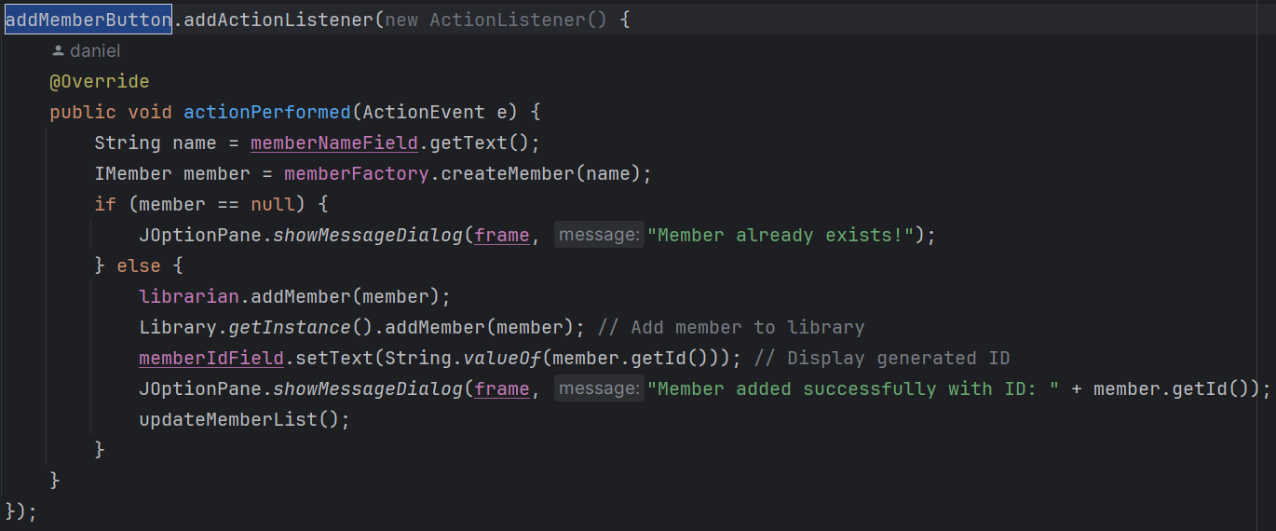
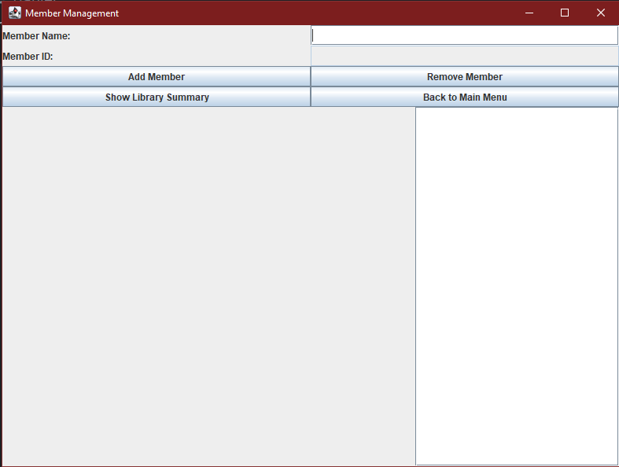
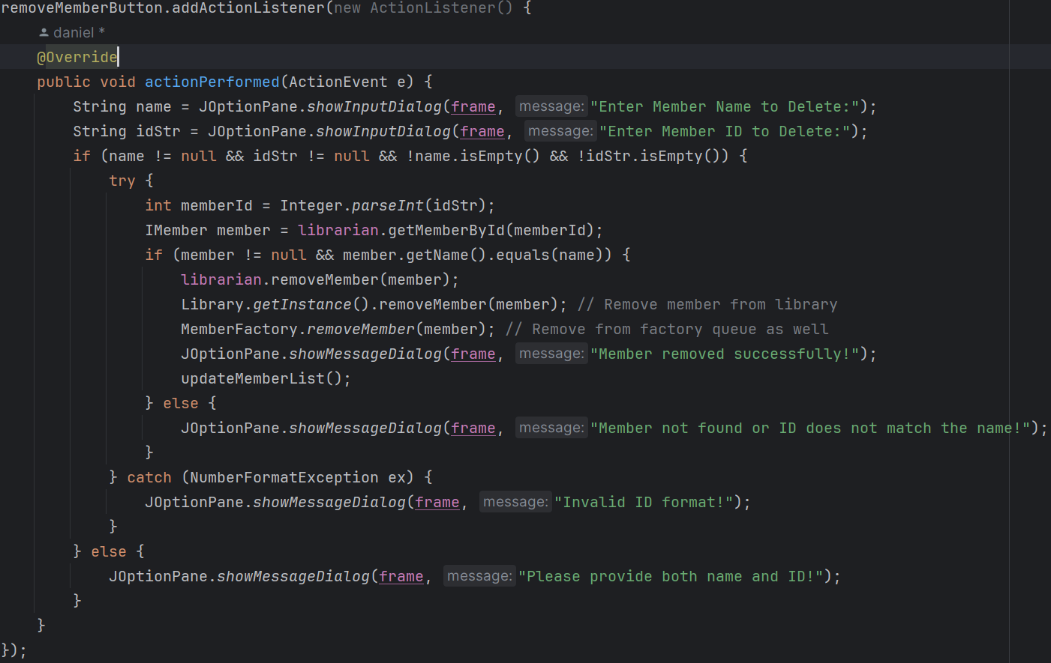
Screen shot Snippets:

Slide 7

Book Management:
Features:
Adding a Book
Removing a Book
Loaning a Book
Returning a Book
Making an Unavailable Book Available
Code Snippets:
Adding a Book
Removing a Book
Loaning a Book
Returning a Book
Making an Unavailable Book Available
UI Screenshots:
Book Management Screen

Slide 8
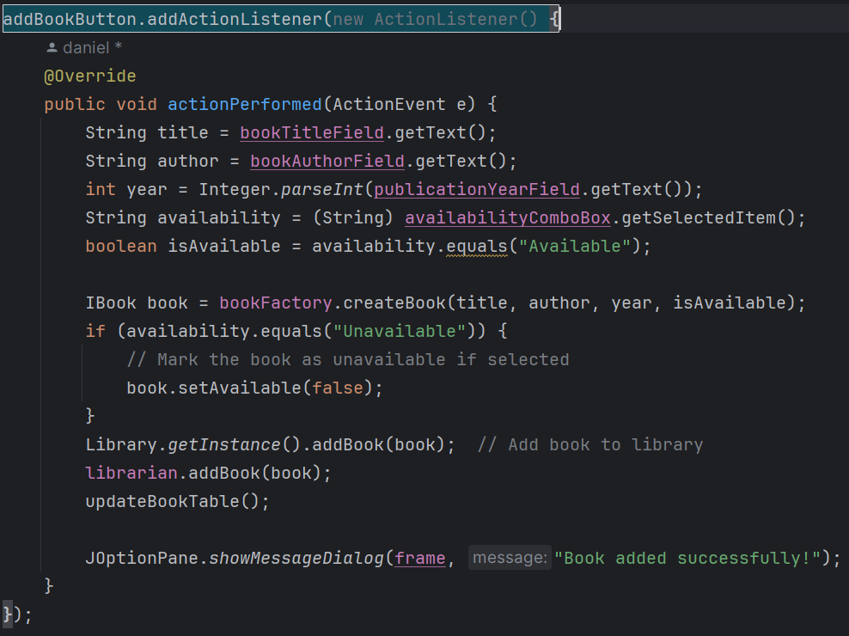
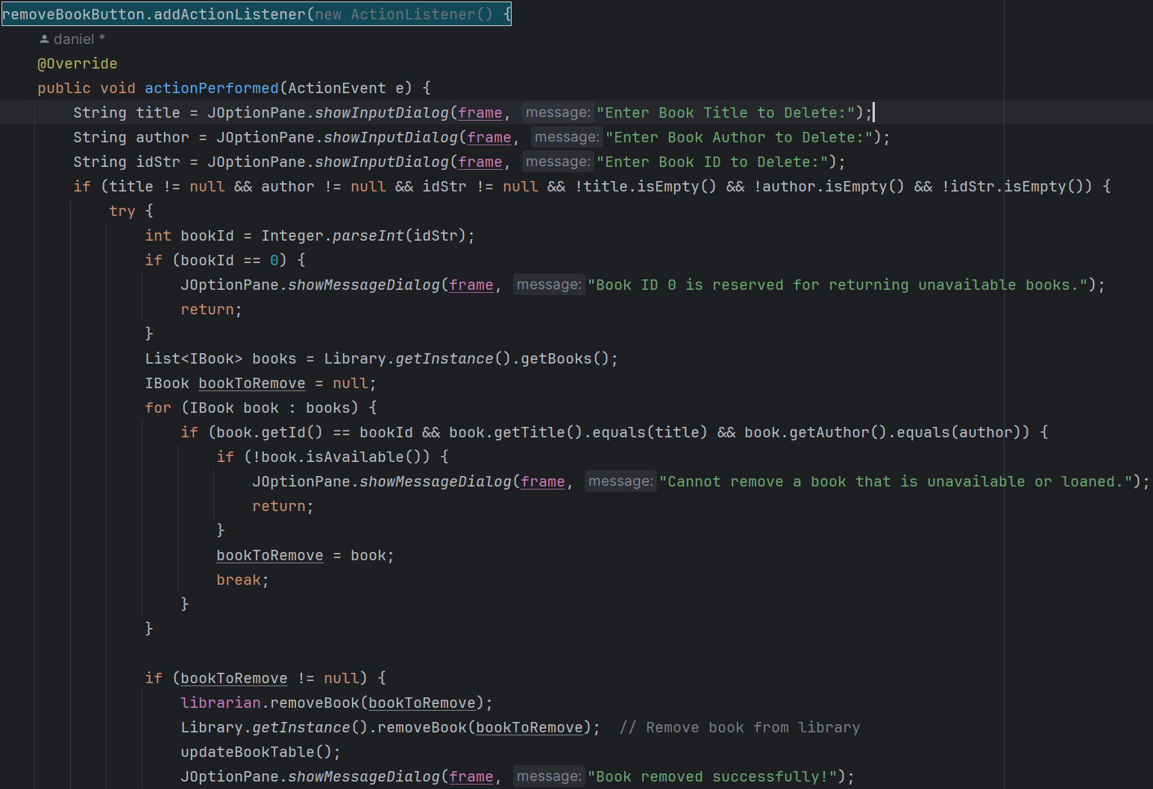
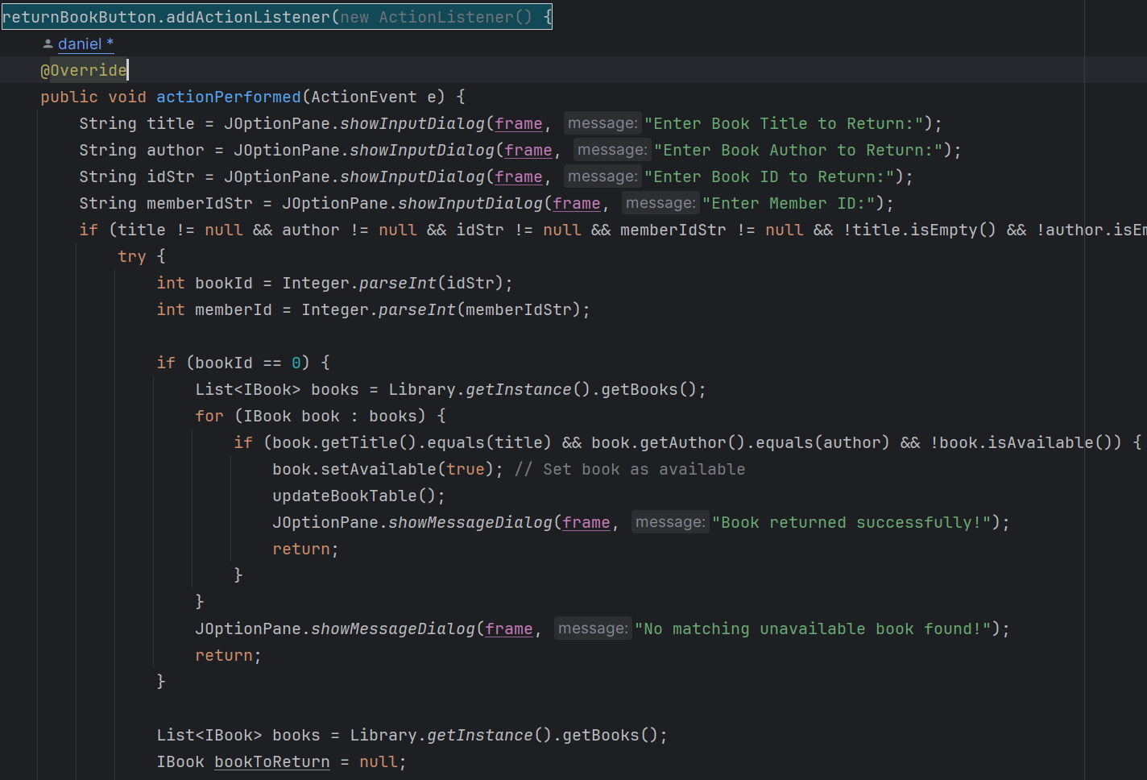
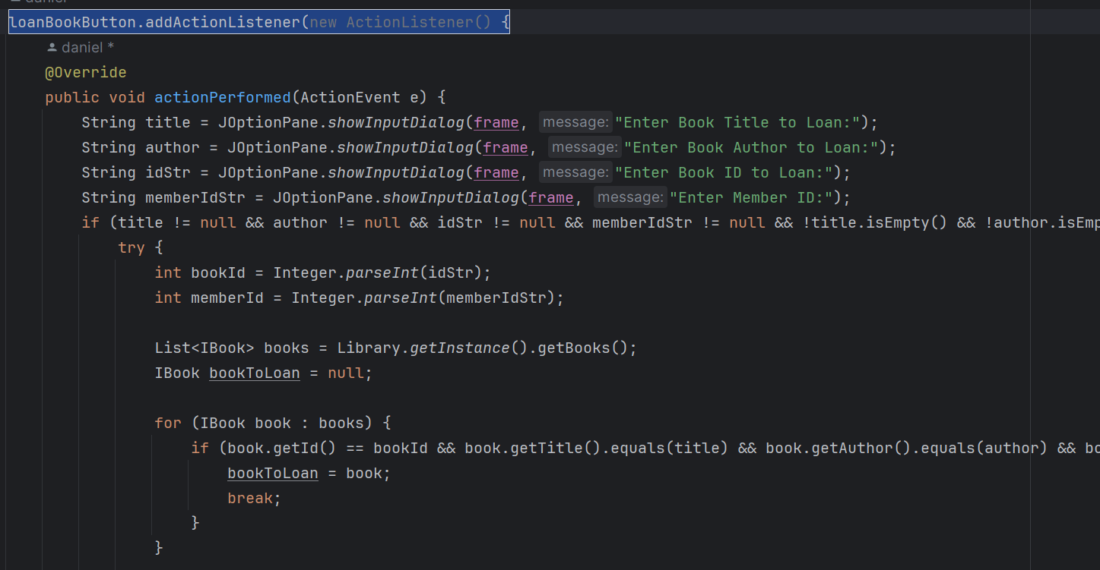
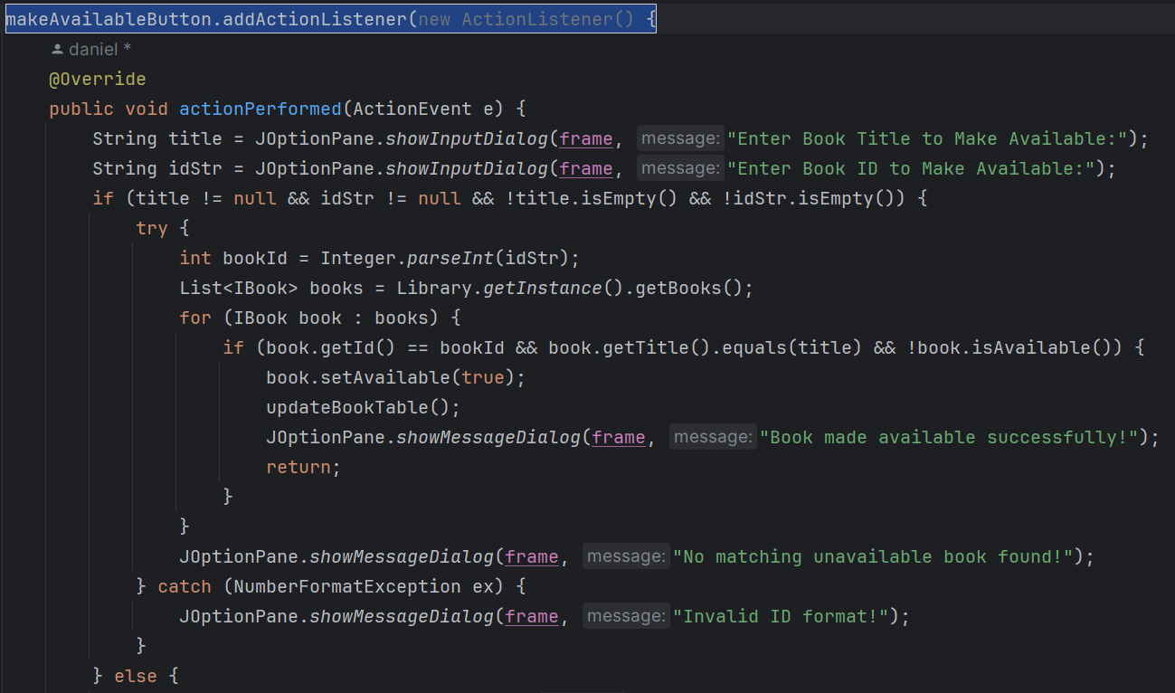
Screen shot Snippets:

Slide 9

Loan Management:
Features:
Loaning and Returning Books
Managing Book Availability
Code Snippets:
Loaning a Book
Returning a Book
UI Screenshots:
Loan Management Screen

Slide 10
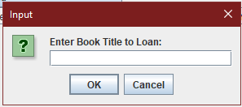
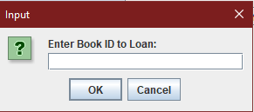
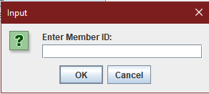
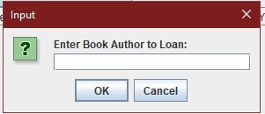
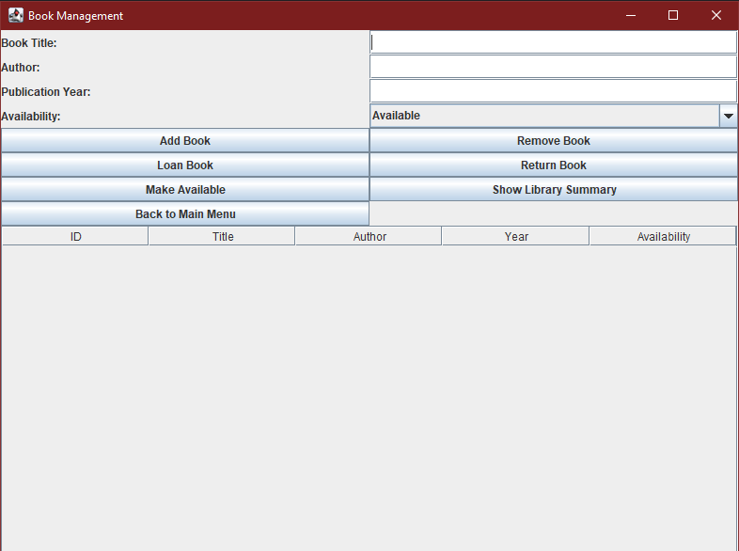
Screen shot Snippets:

Slide 11

User Interface (UI)
Overview of the UI Design
Key UI Components and Their Functionalities
UI Screenshots

Slide 12

Overview of the UI Design:
The Library Management System features a graphical user interface designed using Swing.
The UI allows users to manage members, books, and loans efficiently.
Key UI Components and Their Functionalities:
Main Menu:
Provides navigation to different management screens (Member Management, Book Management, Loan Management).
Member Management Screen:
Allows adding, removing, and listing members.
Book Management Screen:
Allows adding, removing, loaning, returning, and making books available.
Loan Management Screen:
Allows loaning and returning books, and managing book availability.
UI Screenshots:
Main Menu Screen: (Include a screenshot of the main menu)
Member Management Screen: (Include a screenshot of the member management UI)
Book Management Screen: (Include a screenshot of the book management UI)
Loan Management Screen: (Include a screenshot of the loan management UI)

Slide 13
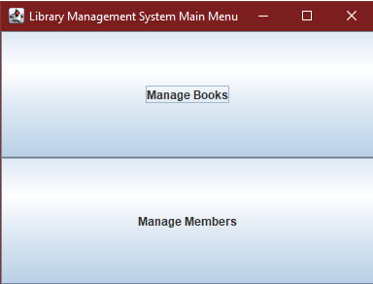
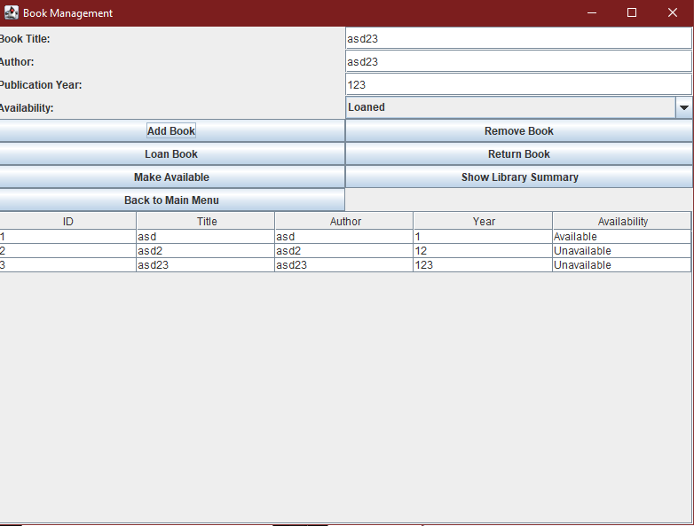
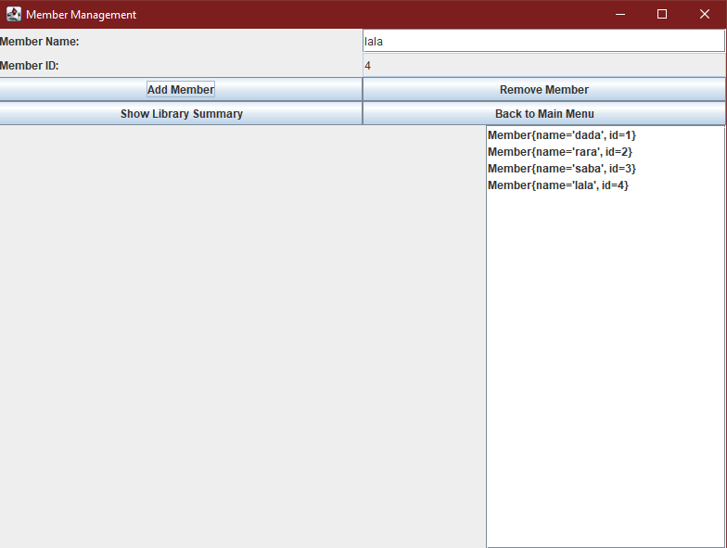
Screen shot Snippets:

